Slide 1
Viral origin

Slide 2
What are viruses?
Viruses are acellular organisms
completely obligatory parasites.
The term virus means ‘poison’.
Most of them are disease causing
Have a complex mechanism of hijacking the machinery of the host genome for its self replication.

Slide 3
Studies of viral origin: a challenge
no strong evidence -from where all the viruses came in existence.
The reason:
no fossils and paleontological evidence.
obligatory life cycle: their individual existence nil and thus they are destroyed along with the death of cell or organism.
most of the viral origin studies - done by comparing and analyzing leftovers of viral genome like DNA and RNA molecules.

Slide 4
Theories of viral origin
Three hypothesis proposed on the origin of viruses -on the basis of present day evidences:
Regressive or retrograde hypothesis
Cellular origin hypothesis
Co-evolution hypothesis
Note: they are still hypothesis with lots of flaws and drawbacks

Slide 5
Regressive hypothesis
Emphasizes the descendency of the viruses from more complex ancestors-
Viruses may have once been small cells that parasitized larger cells. Over time, genes not required by their parasitism were lost.
autonomous organisms initially developed a symbiotic relationship. Over time, the relationship turned parasitic, as one organism became more and more dependent on the other. As the once free-living parasite became more dependent on the host, it lost previously essential genes.
Eventually it was unable to replicate independently, becoming an obligate intracellular parasite, a virus.

Slide 6
Evidence supporting the hypothesis of regression
Evolution of Large DNA Viruses eg nucleocytoplasmic large DNA viruses (NCLDVs),
best explained with the help of this hypothesis since many of them have huge genome along with many complex enzyme systems carried along with them, they are concluded to be the descendants of complex independently living extremely small microorganism.
Pox virus

Slide 7
It includes the following viruses in general:
Smallpox virus.
Brick shaped Poxvirus
Mimivirus (recently discovered) infect protozoans
In addition to their large size, the NCLDVs exhibit greater complexity than other viruses have and depend less on their host for replication than do other viruses.
Poxvirus particles, for instance, include a large number of viral enzymes and related factors that allow the virus to produce functional messenger RNA within the host cell cytoplasm.

Slide 8
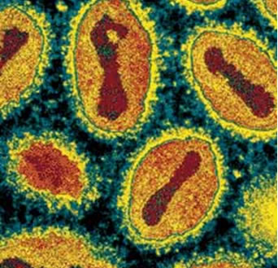
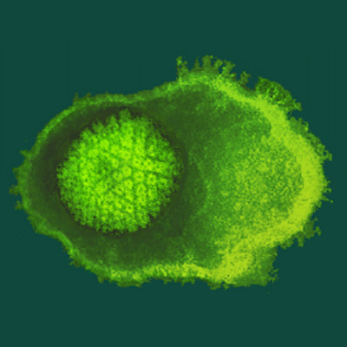
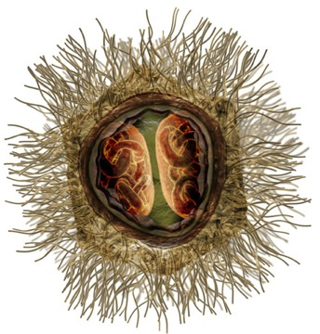
Small pox virus
Mimivirus

Slide 9
Interestingly, Mimivirus does not differ appreciably from parasitic bacteria, such as Rickettsia prowazekii.
Many other living present day organisms like Rickettsia, chlamydia. Mycoplasma etc. are very much similar to the virus that exist today, it has been hypothetically projected that these organisms are in the same process of regression and becoming a virus.
The endoparasitism derived from endosymbiotic beginning can also be explained by the proposed fact that mitochondria and Rickettsia have common free living ancestors.

Slide 10
Regressive or retrograde theory fails to explain origin of small
Viruses, especially RNA viruses and viroids. Which are better
Explained by the escaped gene theory

Slide 11
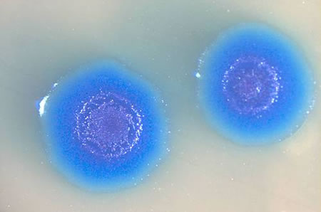
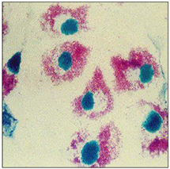
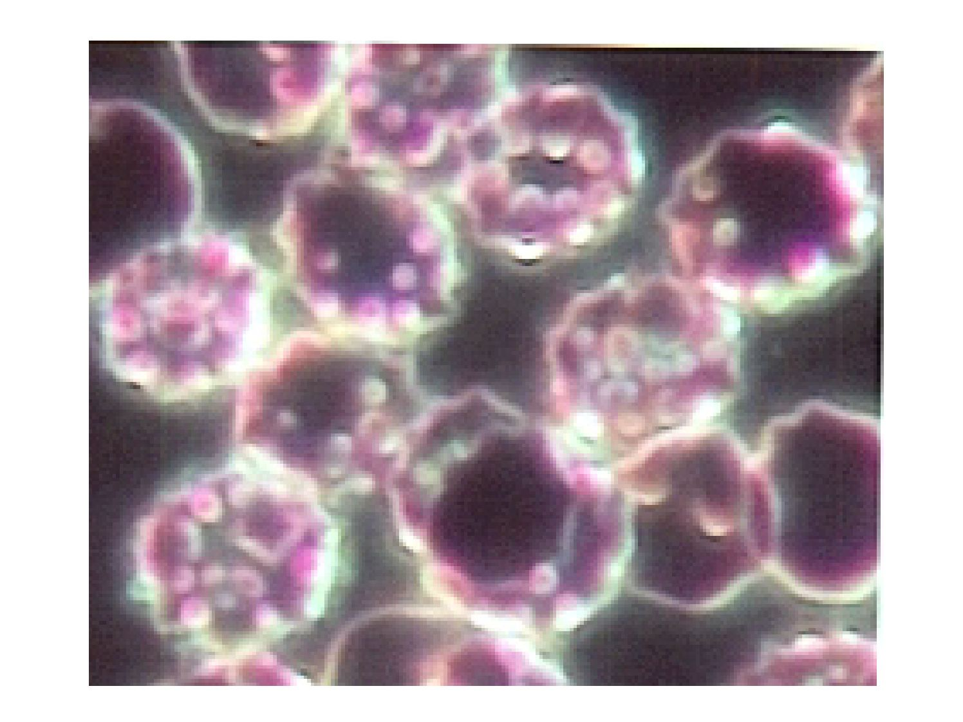
Mycoplasma
Rickettsia
Chlamydia

Slide 12
Cellular origin or escaped gene hypothesis
According to this hypothesis, viruses originated through a progressive process. Mobile genetic elements, pieces of genetic material capable of moving within a genome, gained the ability to exit one cell and enter another.
Eukaryotic genome parts like transposons and plasmids ( generally capable of escaping into other cells), a major component of prokaryotic cell genome, are the responsible molecules for the basis of viral genomes.

Slide 13
Evidence supporting cellular origin hypothesis
Retro viruses can be best explained with this theory.
Viruses consisting of RNA as their genome replicates very much the same way as transposons jumps in genome.
Transposons make up an astonishing 42% of the human genome (Barbara Mclintoff) and can move within the genome via an RNA intermediate.

Slide 14
Like retroviruses, certain classes of retrotransposons, the viral-like retrotransposons, encode a reverse transcriptase and, often, an integrase. With these enzymes, these elements can be transcribed into RNA, reverse-transcribed into DNA, and then integrated into a new location within the genome.

Slide 15
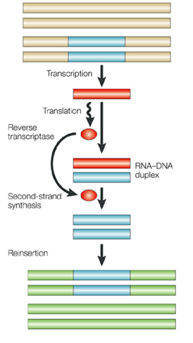

Slide 16
We can speculate that the acquisition of a few structural proteins could allow the element to exit a cell and enter a new cell, thereby becoming an infectious agent.
Indeed, the genetic structures of retroviruses and viral-like retrotransposons show remarkable similarities.

Slide 17
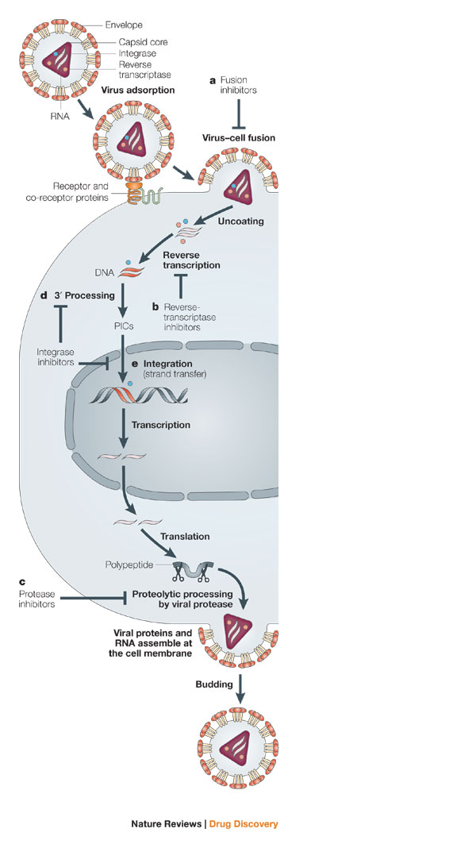

Slide 18
Co-evolution hypothesis
Viruses may have evolved from complex molecules of protein and nucleic acid at the same time as cells first appeared on earth and would have been dependent on cellular life for many millions of years.

Slide 19
Evidence supporting co-evolution hypothesis
Viroids are important pathogens of plants. They do not code for proteins but interact with the host cell and use the host machinery for their replication.
The hepatitis delta virus of humans has an RNA genome similar to viroids but has protein coat derived from hepatitis B virus and cannot produce one of its own. It is therefore a defective virus and cannot replicate without the help of hepatitis B virus.

Slide 20
the virophage 'sputnik' is dependent on mimivirus, which infects the protozoan '‘Acanthamoeba castellanii''. These viruses that are dependent on the presence of other virus species in the host cell are called ''satellites'' and may represent evolutionary intermediates of viroids and viruses.

Slide 21
Prions are infectious protein molecules that do not contain DNA or RNA.
They cause an infection in sheep called scrapie and cattle bovine spongiform encephalopathy.
They are able to replicate because some proteins can exist in two different shapes and the prion changes the normal shape of a host protein into the prion shape.
This starts a chain reaction where each prion protein converts many host proteins into more prions, and these new prions then go on to convert even more protein into prions.
Although they are fundamentally different from viruses and viroids, their discovery gives credence to the idea that viruses could have evolved from self-replicating molecules.

Slide 22
The virus-first hypothesis: a new approach
Koonin and Martin (2005) postulated that viruses existed in a precellular world as self-replicating units.
Over time these units, became more organized and more complex. Eventually, enzymes for the synthesis of membranes and cell walls evolved, resulting in the formation of cells. Viruses, then, may have existed before bacteria, archaea, or eukaryotes.

Slide 23
Most biologists now agree that the very first replicating molecules consisted of RNA, not DNA. We also know that some RNA molecules, ribozymes, exhibit enzymatic properties; they can catalyze chemical reactions. Perhaps, simple replicating RNA molecules, existing before the first cell formed, developed the ability to infect the first cells.

Slide 24
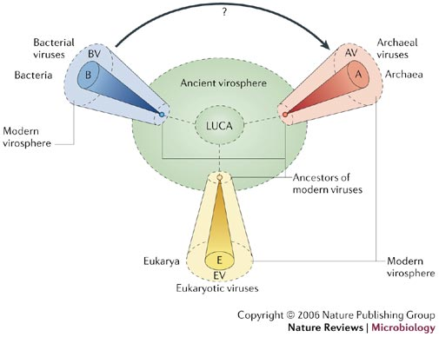

Slide 25
precursors of today's NCLDVs led to the emergence of eukaryotic cells.
Villarreal and DeFilippis (2000) and Bell (2001) described models explaining this proposal. Perhaps, both groups postulate, the current nucleus in eukaryotic cells arose from an endosymbiotic-like event in which a complex, enveloped DNA virus became a permanent resident of an emerging eukaryotic cell.

